Slide 1
Ergogenic Aids Evaluated

Slide 2
Objectives
Describe the benefits of carbohydrate loading
Describe the negative aspects of carbohydrate loading
Compare and contrast each of the following ergogenic aids
L-carnitine -Creatine
Chromium -Choline
Coenzyme Q10 -Pyruvate

Slide 3

Carbohydrate Loading
Popular method to increase glycogen reserves
Normally, each 100 g of muscle contains about 1.7 g of glycogen
Carbohydrate loading packs up to 5 g of glycogen per 100 g of skeletal muscle

Slide 4
Carbohydrate Loading, continued
Reduced the muscle’s glycogen content with prolonged exercise
Maintain a low-carbohydrate diet ( about 60-100 g/day) for several days
Glycogen depletion increases formation of glycogen-storing enzyme glycogen synthetase in the muscle
3 days prior to competition , switch to a high-carbohydrate diet (400-700 g/day)

Slide 5
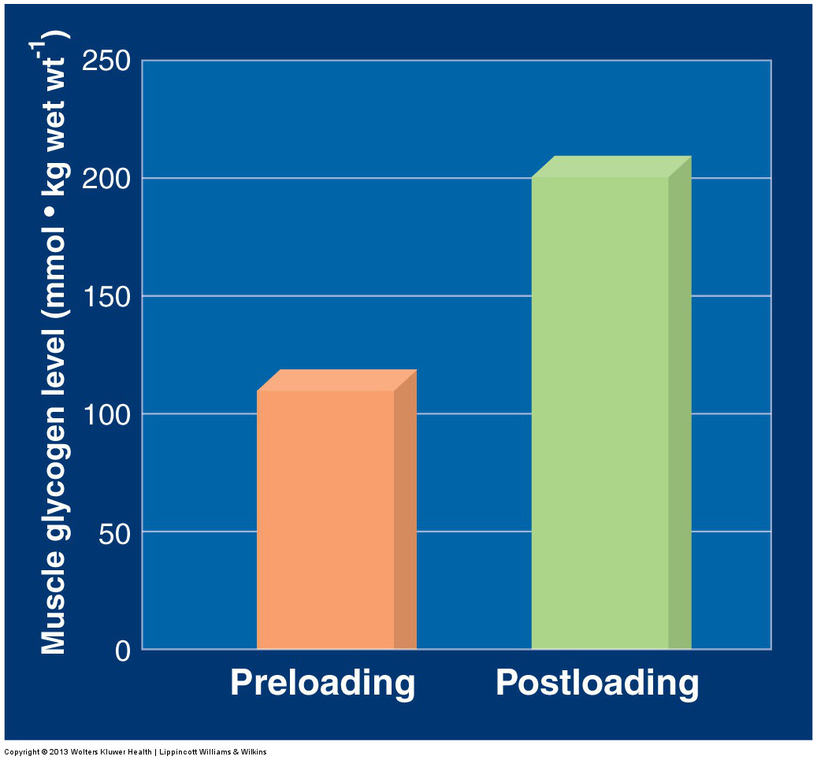

Slide 6
Negative Aspects of Carbohydrate Loading
Only benefits intense aerobic activities lasting > than 60 minutes
Causes a person to feel “heavy” due to the addition of 2.7 g of water with each gram of glycogen stored
Negatively affects individuals susceptible to:
T2DM
Heat disease
Muscle enzyme deficiencies
Renal Disease

Slide 7
Amino Acid Supplementation
Fact or Fiction?
The use of amino acid supplements boosts the body’s natural production of anabolic hormones
Research on healthy subjects does not provide evidence for an ergogenic effect of a general dietary increase of amino acid supplements on:
Hormone secretion
Training responsiveness
Exercise performance

Slide 8
Overview of Various Ergogenic Aids

Slide 9
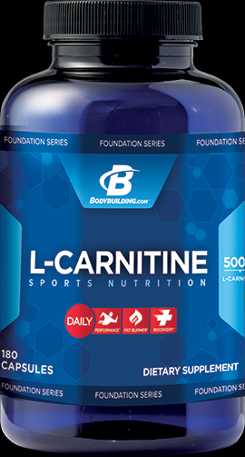
l-Carnitine
A short-chain carboxylic acid containing nitrogen
Found mostly in meat and dairy products
Liver and kidneys synthesize L-carnitine from methionine and lysine
Vital to normal metabolism

Slide 10
l-Carnitine, continued
Few data suggest that healthy adults require carnitine above levels in a well-balanced diet
Research shows:
No ergogenic benefits
No positive metabolic alterations aerobic or anaerobic
No enhanced recovery effect
No body fat-reducing effects

Slide 11
Benefits of l-Carnitine
Acts as a vasodilator in peripheral tissues
May enhance regional blood flow and oxygen delivery
Might improve oxygen supply to injured tissue and promote clearance of muscle damage byproducts

Slide 12
Chromium
For athletes with chromium-deficient diets, prudent use of chromium supplements seem appropriate
Poor intestinal absorption of chromium chloride is a main hindrance to effective supplementation
Chromium picolinate is absorbed better by the body

Slide 13
Negative Effects of Chromium
Completes with iron for binding to transferrin
Excessive dietary chromium inhibits zinc and iron absorption

Slide 14
Coenzyme Q₁₀
Found primarily in meats, peanuts, and soybean oil
Functions as an integral component of the mitochondrion’s electron transport system
Lipid soluble
Exists in high concentrations within myocardial tissue
Has antioxidant properties

Slide 15
Coenzyme Q_{10, continued}
Research has found that coenzyme Q₁₀ does not:
Improve aerobic capacity
Improve endurance performance
Improve plasma glucose
Improve lactate levels at submaximal workloads
Improve cardiovascular function

Slide 16
Creatine
Meat , poultry , and fish provide rich sources of creatine
The body synthesizes about 1-2 g daily, primarily in the kidneys, liver, and pancreas,
Governing bodies do not consider creatine an illegal substance

Slide 17
Creatine, continued
Supplementation exerts the following 3 effects in individuals involved in power-type physical activities:
Improves repetitive performance in muscular strength and power activities
Augments short bursts of muscular endurance
Provides for greater muscular overload to enhance training effectiveness

Slide 18
Risks Associated With Creatine Supplementation
Short-term use in healthy men has produced no detrimental effect on blood pressure, plasma creatine , plasma CK activity, or the renal response
Individuals with suspected renal malfunction should refrain from creatine supplementation

Slide 19

Choline
Important compound from normal cellular functioning
Must be obtained in the diet
Choline functions to depress accumulation of fat in the liver or to increase fatty acid uptake by the liver

Slide 20
Medium-Chain Triacylglycerols
Provide a rapid source of fatty acid fuel
Marketed to sports enthusiast as a fat burner , energy source , glycogen sparer , and muscle builder
The water-solubility of medium-chain fatty acids enables them to movie across the intestinal mucosa directly into the bloodstream

Slide 21
Medium-Chain Triacylglycerol Supplements
Supplements of these lipids might spare liver and muscle glycogen during high-intensity aerobic exercise
Conflicting research exists about their use during exercise
Cramping and diarrhea often accompany excess intake of this lipid form

Slide 22
(—)-Hydroxycitrate
Promoted as a natural fat burner to facilitate weight loss and enhance endurance performance
Research findings indicate that increasing plasma HCA availability with supplementation exerts no effect on skeletal muscle fat oxidation during rest or exercise

Slide 23
Pyruvate
Three-carbon end product of the cytoplasmic breakdown of glucose in glycolysis
Exogenous pyruvate allegedly augments endurance exercise performance and promotes fat loss
Several reports indicate beneficial effects of exogenous pyruvate on endurance performance

